Slide 1

ULA HAZRAT
CYBER SECURITY ENGINEER
NCBA
CYBER SECURITY

Slide 2
CYBER SECURITY OBJECTIVE;
CONFIDENTIALITY
INTEGRITY
AVAILABILITY

Slide 3

Internet
Applications
D.I.Y videos
Cloud
Technlogy getting cheaper
1

Slide 4
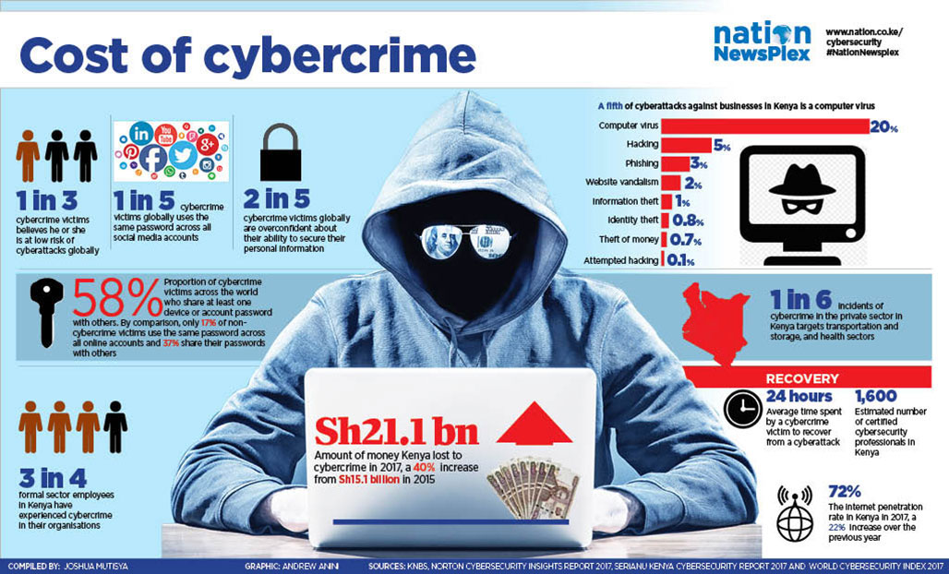
DAMAGE DONE;

Slide 5
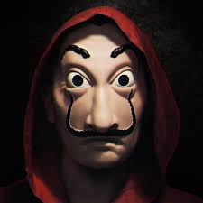
Know thy enemy
Know your enemy
Script kiddies
Cyber gangs
Nation States

Slide 6

How do they do it?
Exploit Vulnerability
Phishing Attempts
Ransomware
Virus
APT
Rootkits
Backdoors

Slide 7

H
A
C
K
I
N
G
PUBLIC WEB
DARK WEB
DEEP WEB

Slide 8


Slide 9


Slide 10
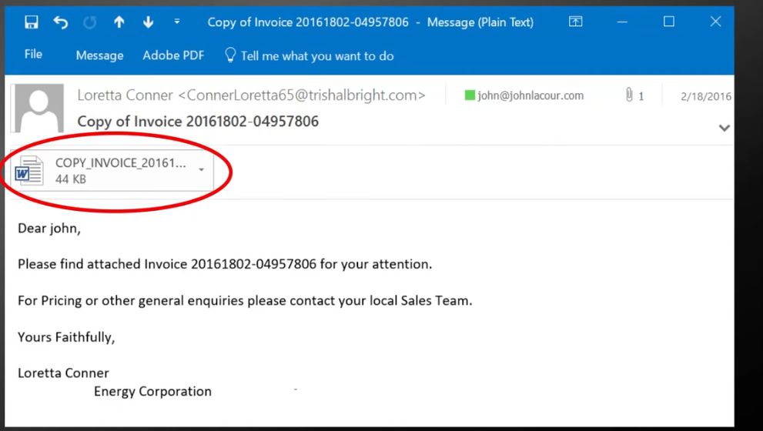
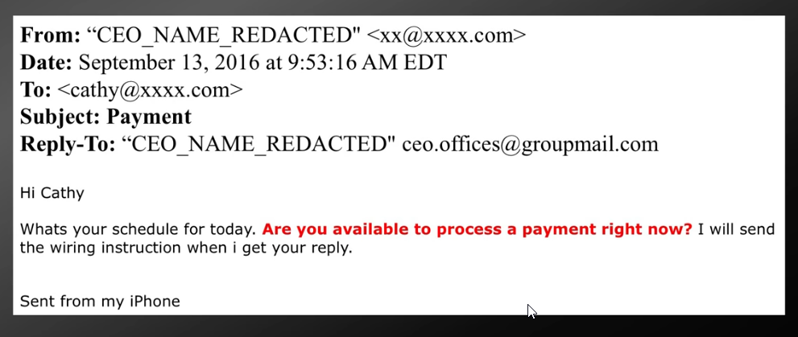
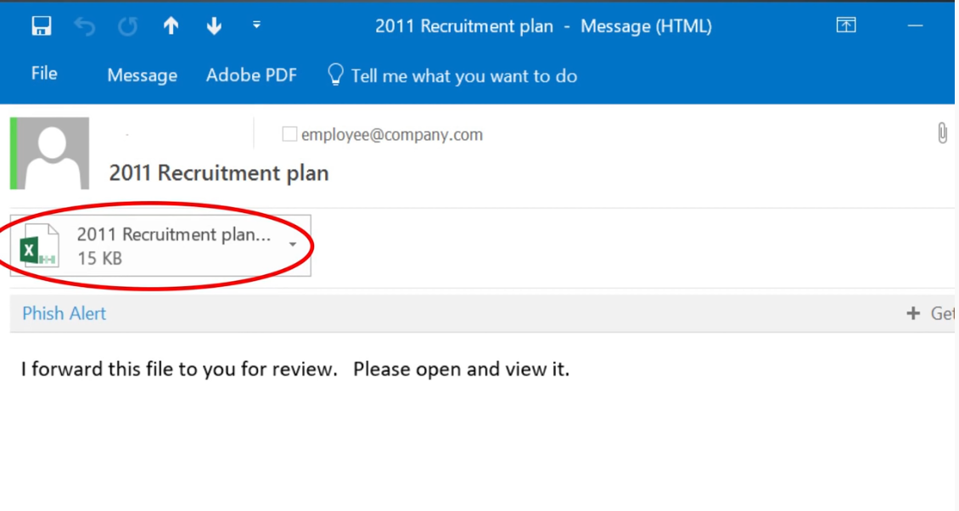

Slide 11

Do need it, do not use it
Fasten your security seat belt
Be paranoid

Slide 12
